Slide 1

IDAC-α An α Dosimetry Software
Martin Andersson

Slide 2
An α Dosimetry Software
Background
IDAC-α applies to α-emitters with a long decay chain of daughter nuclides:
²²⁵Ac
²¹²Bi
²¹³Bi
²¹²Pb
^{223/224}Ra
¹⁴⁹Tb
²²⁷Th
Dosimetry for α-emitting radiopharmaceuticals is performed based on the arbitrary assumption that the daughter radionuclides follow the Biokinetic (BK) Model of the parent.
Aim: Create a more realistic α-Therapy specific Dosimetry Model

Slide 3
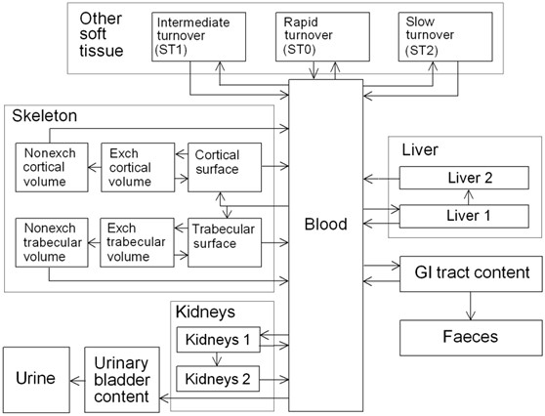
IDAC-α platform
Individual BK Models for all Daughter Radionuclides are incorporated
Radium (Ra) BK Model
Complex BK Model (visual representation)
Rn-219 (α, 3.96s)
Po-215 (α, 1.78ms)
Pb-211 (α, 36.10min)
Bi-211 (α, 2.17min)
Tl-207 (α, 4.77min)
(ICRP, 2017. Occupational intakes of radionuclides: Part 3. ICRP Publication 137. Ann. ICRP 46(3/4))
T (0)
T
Computation time <2 seconds

Slide 4
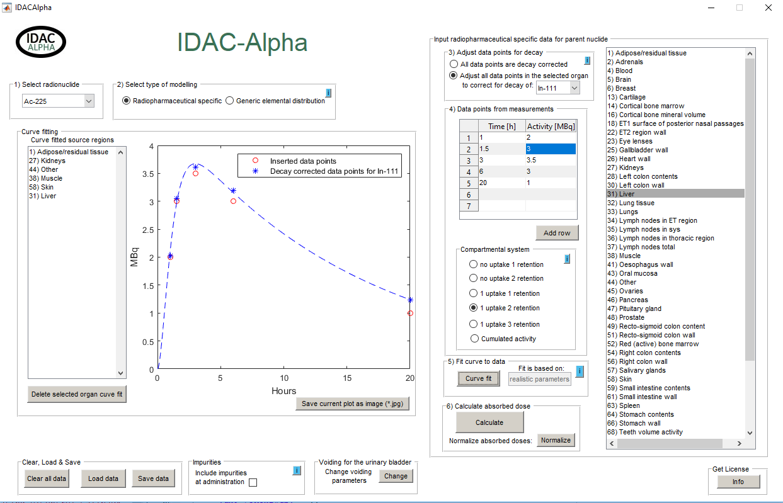
Software
The User Interface
3 Select Organ
1 Select Nuclide
2 Select Modeling Type
4 Insert Data

Slide 5
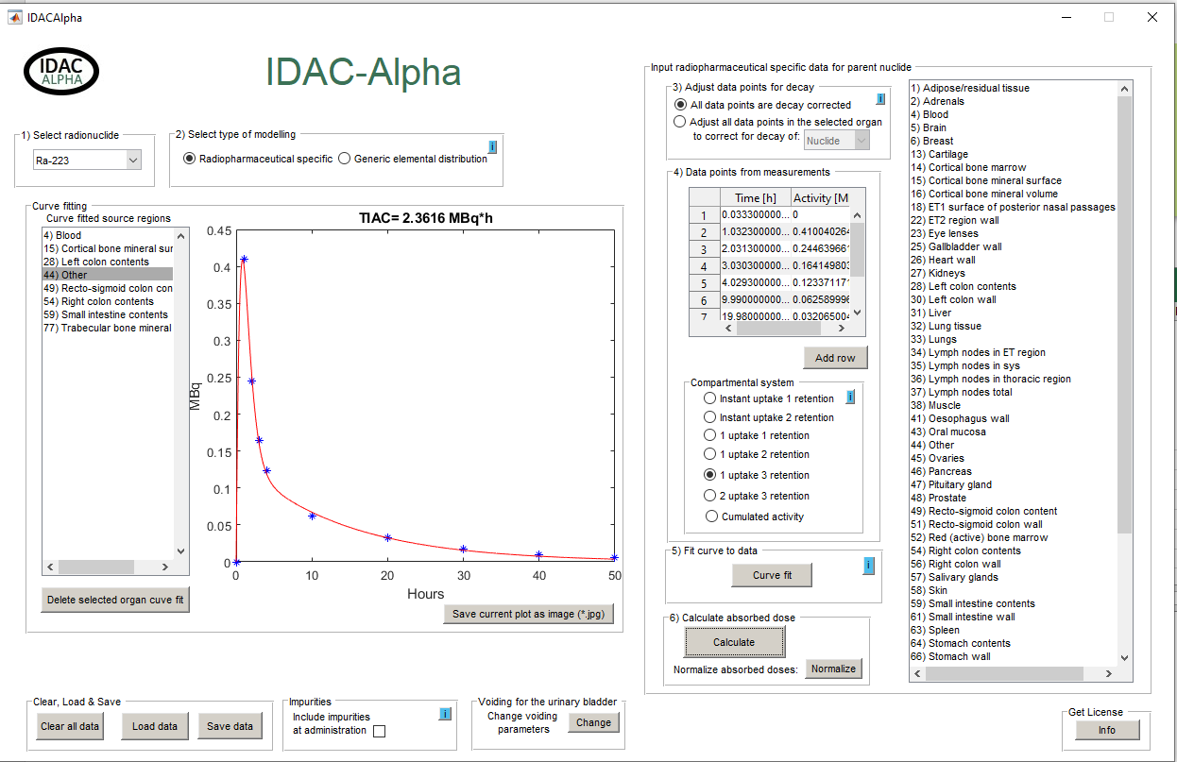
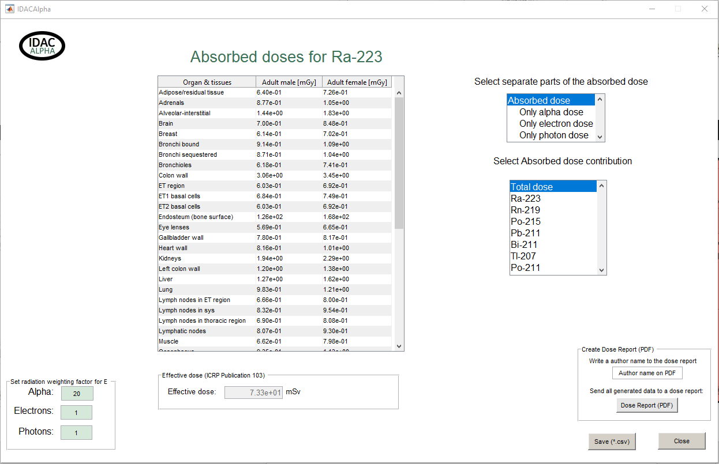
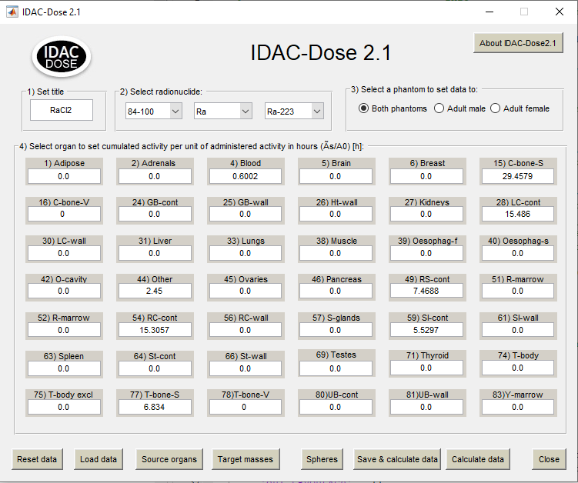
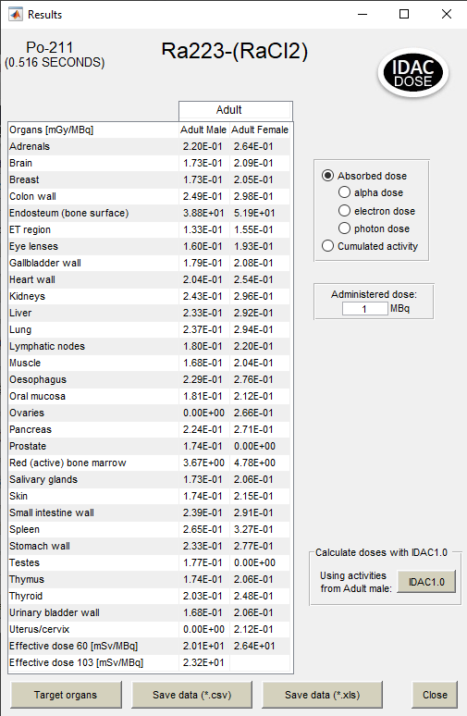
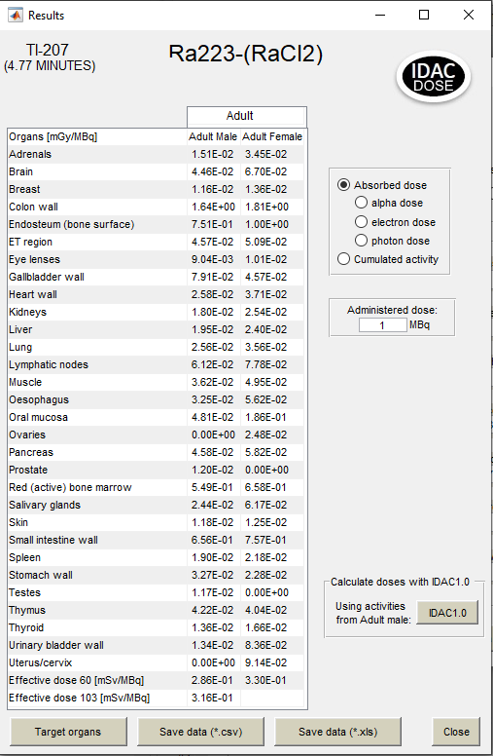
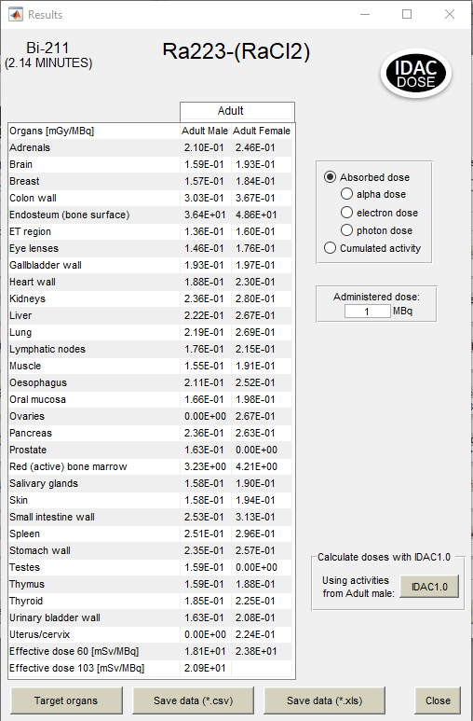
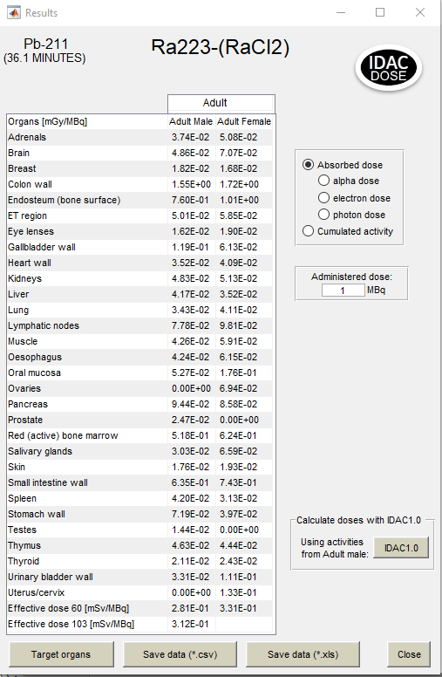
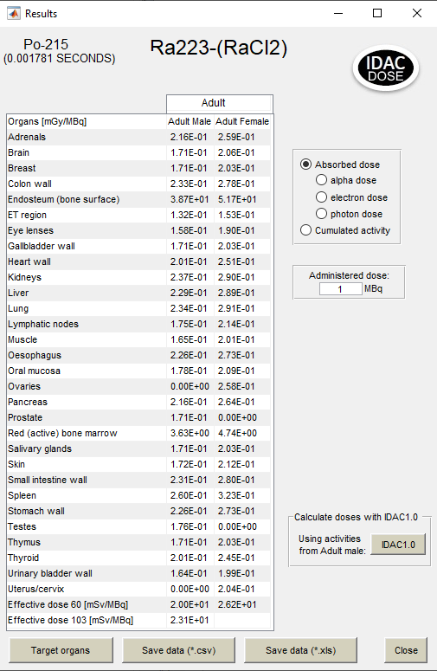
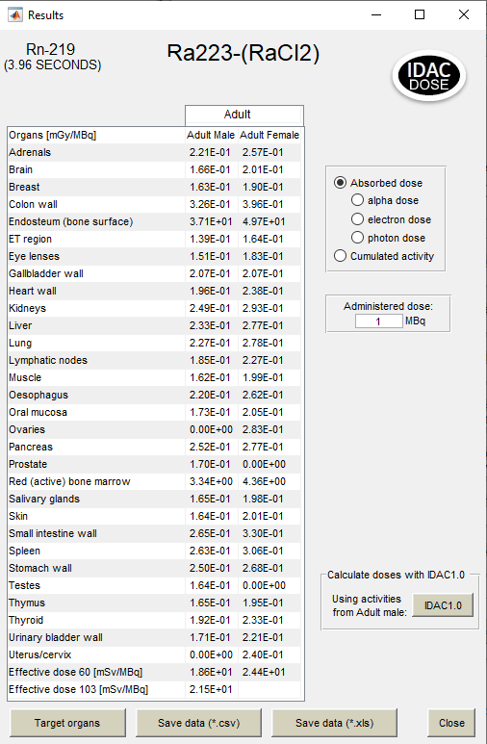
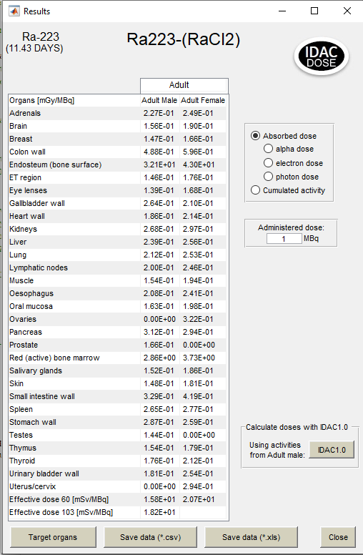
IDAC-α vs Conventional Dosimetry ²²³RaCl₂ Paradigm
IDAC-α Dosimetry Calculations
Dosimetry is calculated for all Radionuclides in a Unified BK Model
Absorbed doses are calculated using the ICRP framework of internal dosimetry
Conventional Dosimetry Calculations
Dosimetry is calculated independently for each Radionuclide
Ref: Taprogge J, et al. Int J Radiat Oncol Biol Phys. 2019 Jul 23. pii: S0360-3016(19)33505-9. doi: 10.1016/j.ijrobp.2019.07.022.

Slide 6
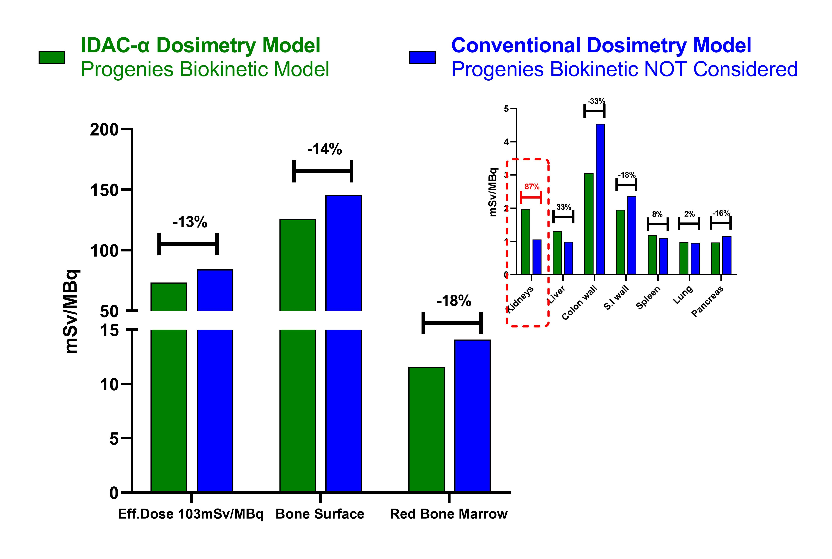
Impact on Dosimetry Estimation
IDAC-α eliminates the error of overestimation or underestimation on tissue Absorbed Dose (A.D.)
²²³Ra Internal Generator Example
Overestimations
Underestimations
Decreased A.D. to Bone Surface and Bone Marrow by 14% and 18%, respectively
Daughter Nuclides follow different biokinetic model → Decreased Bone deposition → Decreased A.D.
Increased A.D. in Liver and in Kidneys by +33% and +87%, respectively.
Increased Radiation Exposure due to Daughter Nuclides catabolic products retention and excretion
Accurate prediction on healthy tissue toxicity

